Slide 1
Blockchain, Bitcoin & Lisk
A brief introduction to the Blockchain eco-system and deepening on Lisk
Andrea F Speziale | Remo Bonfante
03/04/17 Milano

Slide 2
Blockchain & Bitcoin

Slide 3
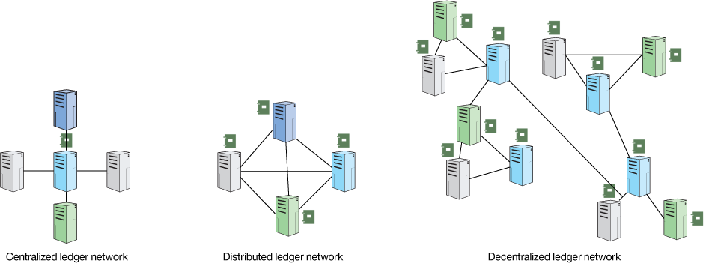
Cos’è la Blockchain?
DECENTRALIZED LEDGER | LIST OF BLOCKS | TAMPER RESISTANT
Notes:
“Base di dati distribuita” Accennare alla distinzione tra modello centralizzato VS decentralizzato

Slide 4
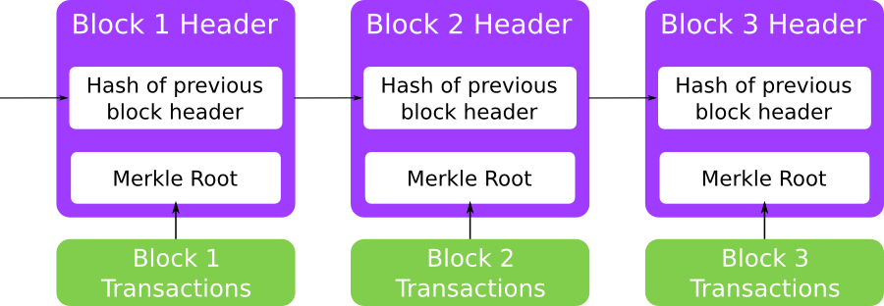
What is the Blockchain?
A list of concatenated blocks
Blocks are not editable after their insertion in the chain
Security provided by cryptography

Slide 5

What is the Blockchain?
New blocks are appended in the chain with a process called mining
Mining is an expensive process and need a growing amount of resources
Miners compete for the creation of the next block
Miners receive a reward for every mined block
Notes:
Elementi grafici
“ e qual è il processo che porta all’aggiunta di nuovi blocchi? Il Mining, ovvero l’esecuzione di un algoritmo che regola l’inserimento di un nuovo blocco nella catena. ”

Slide 6



“On top” alla Blockchain?
...
Platforms | Area | Algo
Moneta elettronica
POW Proof of Work
Smart contract
POW (POS) Proof of Work/..Stake
Decentralized storage
POR Proof of Retrievability

Slide 7

Lisk!
& DPOS
Notes:
2. lisk: introdurre lisk, introdurre il dpos, enunciare le feature tecniche di spicco, presentare (con una cronostoria), gli sviluppi in corso

Slide 8
Lisk - intro
22 February - 21 March 2016
ICO Initial Coin Offering
14,009 BTC
about
13,5 millions €
(0,13€) ~ 0.28 € per LSK | ~ 1,1 MLN € volume | ~ 26.9 MLN € market cap

Slide 9
Lisk - intro
Decentralized App Framework
Developed entirely in Javascript
Open Source
DPOS
API & SideChains & SDK

Slide 10
Lisk - js & open source
2017 Stack Overflow Developer Survey
Most popular language? Javascript
Open Source
https://github.com/liskHQ

Slide 11
Lisk - nodo, wallet & API
“Simple and Ready to use”
VPS 2-4GB RAM e 2VCPU
Self-installing node (“bash is lovely”)
Many APIs which handle the communication with the node
(e.g “http(s)://ip:8000/api/loader/status/sync”)

Slide 12
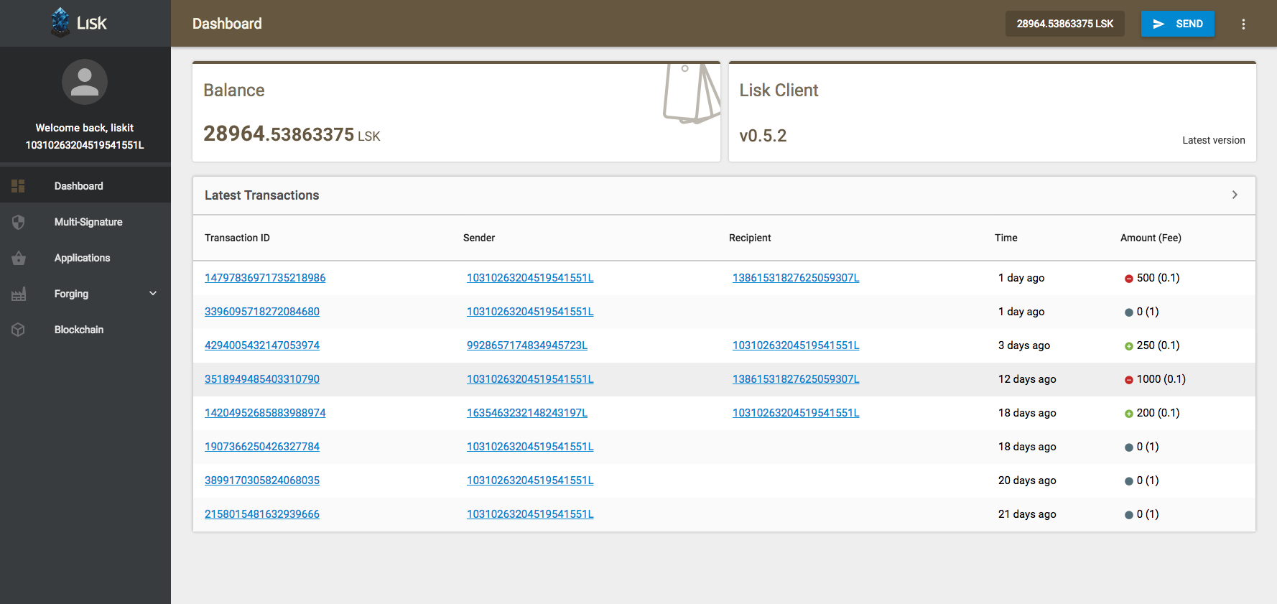
Lisk - nodo, wallet & API
“Super Easy Blockchain gateway”
Notes:
Screenshot wallet, discorso ripreso nel parlare di blockchain app installabili con un click

Slide 13
Lisk - DPOS
Delegated Proof of Stake
network composed by > 950 nodes Mainet | > 400 nodes Testnet
Delegates act as creator for new blocks, voted by the community
forging delegates 101
tot (962) 1091 Mainet | tot (321) 342 Testnet

Slide 14
Lisk - DPOS
Voting system
1 LSK x 33 votes for a total of 101
Forging & Reward
Delegate Round / 10 sec per Block
5 LSK 1 year | 4 LSK 2 year | 3 LSK 3 year | 2 LSK 4 year | 1 LSK from 5

Slide 15
Lisk - attori
Users
Merchants
BlockChain Apps users
Delegate
Network guard
Lisk forger
Developer
Services developer using API / SDK

Slide 16
Lisk - development
current Version (+ 1 version)
0.7.0 on Mainet | 0.8.0a on Testnet
2016?
Forging Community | Foundation | </Code Improvements>

Slide 17
Lisk - sidechains, BAPPs & SDK
2017?
“Lisk is growing faster!”

Slide 18
Lisk - sidechains, BAPPs & SDK
LiskJS 20/03/17
The Lisk-JS library now contains an API Wrapper, cryptographic tools, helper functions for developers to make their application more secure.

Slide 19

Lisk - sidechains, BAPPs & SDK
Lisk Rebrand 28/03/17
TAIKONAUTEN AGENCY (https://www.taikonauten.com/)

Slide 20
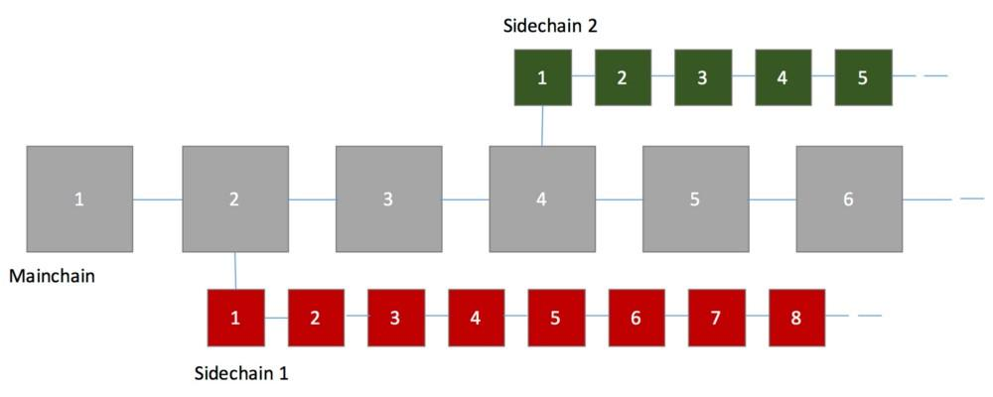
Lisk - sidechains, BAPPs & SDK
“Blockchain Branches”

Slide 21
Lisk - sidechains, BAPPs & SDK
Blockchain Applications
a lot of proposal and concepts
find it on Lisk official website lisk.io

Slide 22
Community &
LIG - Lisk Italian Group
Notes:
Helperbit, Legambiente

Slide 23
Lisk - community
Lisk Channels
Lisk Website chat.lisk.io
Lisk Chat lisk.chat aprox 3473 registered users
Lisk Forum forum.lisk.io
Lisk Blog blog.lisk.io
… twitter, facebook and youtube and more!

Slide 24
Lisk - community
Lisk Tools
Lisk Network explorer.liskwallet.net
A lot of Guidelines and installation/monitoring
node tools
telegram bots and more
* everything is reported on the Lisk forum!

Slide 25
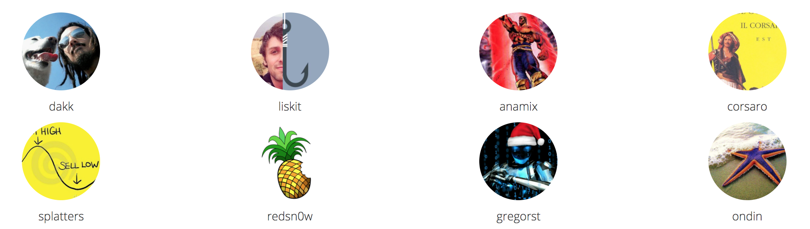
Lisk - LIG LISK ITALIAN GROUP
Group Website liskitaliangroup.github.io
8 Italian delegates committed in
Dissemination | Coding | FULIG

Slide 26
Lisk - LIG LISK ITALIAN GROUP
7 contribution to Lisk core & documentation
+ 10 open source projects
Investors using Multi-signature address named FULIG
explorer.liskwallet.net/address/13861531827625059307L
aprox 2K € donation for Italians Earthquake victims

